Slide 1



IE261
EFFICIENT RETRIEVAL OF TOP-10 RELEVANT DOCUMENTS IN FINANCIAL TEXTS
TEAM MEMBERS:
Agata Kazakevic 20230966, Symbat Bekzhigit 20246306

Slide 2


01 | Introduction
04 | Objectives
05 | Workflow
06 | Used methods
07 | Unsuccessful trials
Agenda

Slide 3

01
Retrieval of relevant documents serves as a critical first step in understanding large-scale datasets. It facilitates downstream processes such as classification, summarization, and predictive modeling, enabling the extraction of actionable insights.
Why Retrieving Relevant Documents is Important?
02
Financial data retrieval directly influences decision-making processes in areas such as investment, risk assessment, and regulatory compliance. Errors or inefficiencies in retrieval can lead to suboptimal or incorrect analyses, impacting industries and economies.
03
Unlike general-purpose document retrieval, financial datasets require systems to account for domain-specific semantics, where the importance of contextual understanding goes beyond surface-level keyword matches.

Slide 4
Challenges in Achieving High Relevance and Precision
Sparse and Imbalanced Data
Ambiguity in Natural Language Queries
Domain-Specific Lexicons and Jargon
Numerical and Tabular Data Integration
Large-Scale Data Efficiency

Slide 5

Goal:
Develop a retrieval-augmented generation (RAG) framework capable of efficiently retrieving the top 10 most relevant documents for a given query in a financial domain.
Our objective
Key Challenges to address:
Handling financial terminology and table-text data.
Optimizing retrieval for relevance and efficiency.

Slide 6
7 different datasets: FinDER, FinQABench, FinanceBench, etc.
A set of documents
Example document: Description of MSFT services and products.
A set of queries for testing
Example query: "What are Microsoft's revenue streams?"
Challenge: Aligning retrieval to domain-specific language and structure.
Dataset
Description

Slide 7

Our
Workflow Overview
Step 0:
Preprocessing.
Step 1:
Data Chunking.
Step 2:
Chunk embedding.
Step 3:
Vector Database.
Step 4:
Chunk Retrieval.

Slide 8


Step 0: Preprocessing for Data Quality
Goal:
To clean and validate the dataset for consistent and efficient retrieval.
Methodology:
Validation:
Ensure each document has a non-empty text field.
Assign an empty string ("") to missing or empty title fields.
Pipeline:
Iterate through document list:
Skip documents missing text or with empty text.
Correct missing or empty title fields.
Logging:
Track the number of total, valid, and skipped documents for quality control.

Slide 9
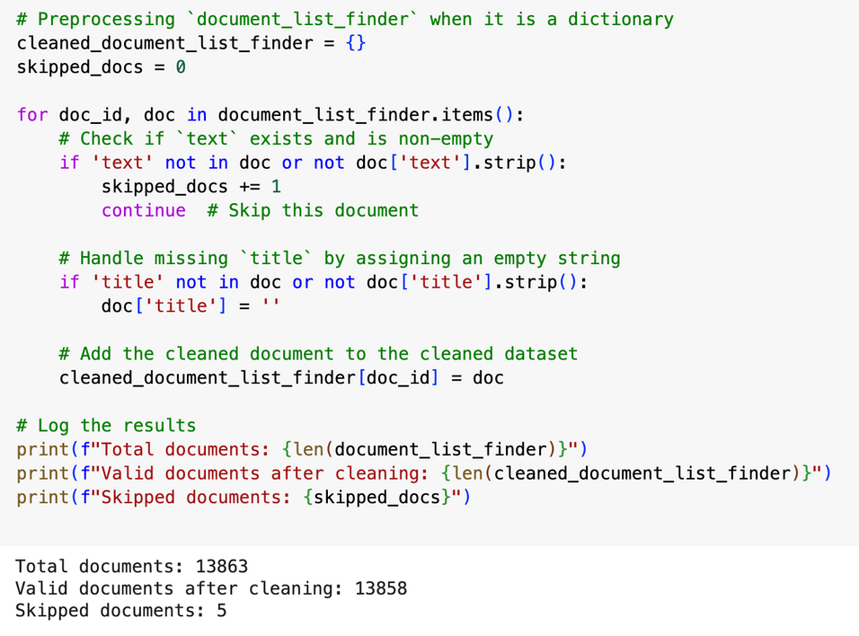
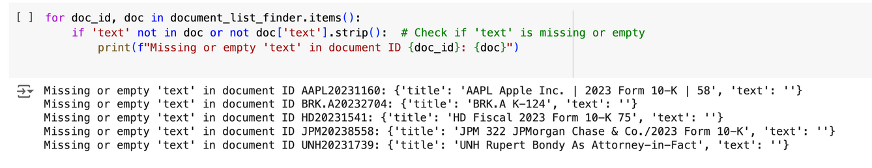
Step 0: Preprocessing for Data Quality
Why Preprocessing?
Improved Data Quality: Ensures only valid documents were processed, reducing noise.
Error Prevention: Avoids issues in downstream retrieval tasks.
Efficiency: Saves computational resources by excluding invalid data.

Slide 10

Step 1: Data Chunking for Better Context Retention
Goal:
To divide large documents in the corpus into manageable chunks while retaining contextual continuity.
Methodology:
Apply Overlap Chunking:
Each document is split into chunks of size chunk_size (e.g., 512 characters).
Overlap of overlap_size (e.g., 256 characters) between consecutive chunks ensures context retention at chunk boundaries.
Processing:
Iterated over the text of each document.
Generated overlapping chunks:
First Chunk: Starts at 0 and includes chunk_size + overlap_size characters.
Subsequent Chunks: Start from chunk_size - overlap_size to ensure overlap.

Slide 11
Step 1: Data Chunking for Better Context Retention
Why Overlap Chunking?
Improved Retrieval:
Overlapping text provides smoother transitions between chunks, capturing relevant information spanning boundaries.
Context Preservation:
Essential for tasks requiring coherent document understanding, such as question answering or re-ranking.
Efficiency:
Creates manageable document sizes for embedding generation and retrieval. Reduces truncation issues in large documents.

Slide 12
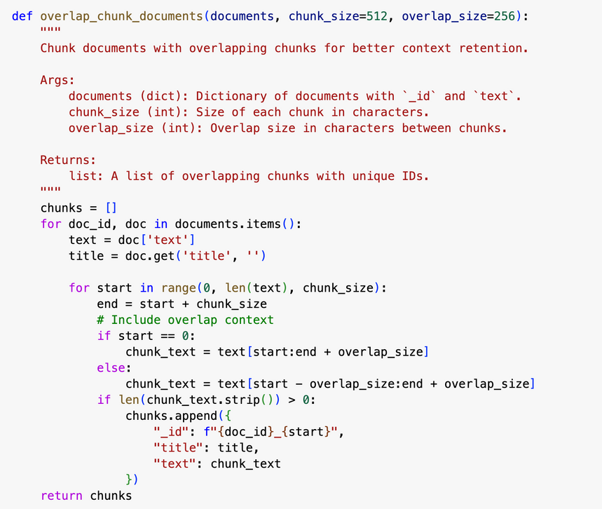
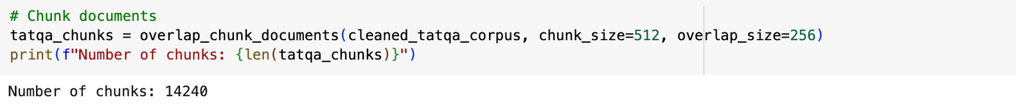
Step 1: Data Chunking for Better Context Retention
Number of chunks generated for all datasets:
Finder: 22,572 chunks
Tatqa: 14240 chunks
FinQABench: 355 chunks
FinanceBench: 573 chunks
FinQA: 25549 chunks
ConvFinQA: 18836 chunks
MultiHiertt: 65204 chunks

Slide 13
Step 2: Chunk Embedding
Goal:
To convert text chunks into numerical representations (dense embeddings) suitable for similarity-based search.
Methodology:
Model Used:
Pre-trained embedding model: Stella EN 400M V5.
Chosen for its balance between computational efficiency and contextual representation quality.
Embedding Techniques:
Mean Pooling:
Aggregates token embeddings by averaging across all tokens.
Effective for capturing overall context in uniform-sized chunks.
CLS Token Pooling:
Uses the [CLS] token for summarizing the sequence.
Pre-trained to represent the overall meaning during model training.

Slide 14
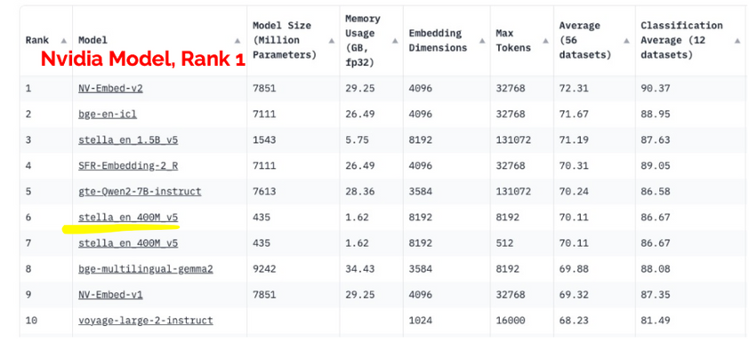
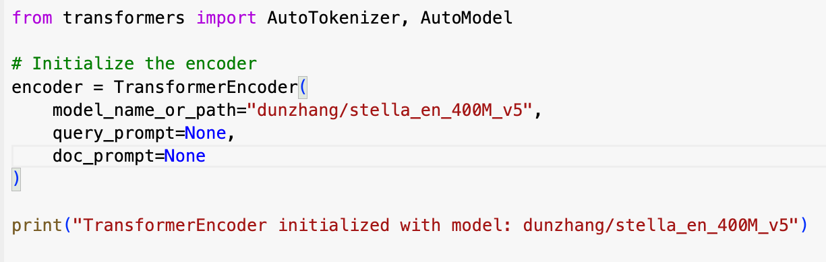
Step 2: Chunk Embedding
Why Stella EN 400M V5?
Top ranked in the Huggingface: Has general-purpose embeddings that work well for many tasks. At 400 million parameters, it strikes a balance between computational efficiency and representation quality.
Efficiency: Handles large datasets effectively on limited GPU resources available to us.
Versatility: Supports both CLS and mean pooling strategies.

Slide 15
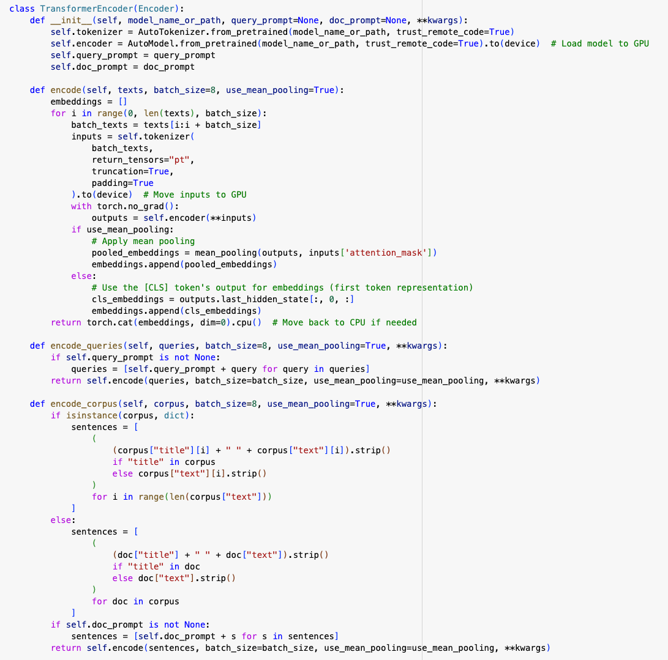

Step 2: Chunk Embedding
Architecture of the TransformerEncoder:
Tokenizer: Converts text into subword tokens .
Encoder:
Transformer Blocks: Multiple layers of self-attention and feed-forward networks:
Self-Attention: Captures relationships between tokens irrespective of their position in the sequence.
Pooling Layer: Reduces the sequence of token embeddings into a single fixed-size vector using:
Notes:
Justification for Using TransformerEncoder:
Domain Adaptation: Stella EN 400M V5 has been pretrained on a wide variety of text, making it capable of understanding the specific language used in financial documents.
Semantic Richness: Transformer-based models capture deep semantic relationships between words, phrases, and their contexts, critical for retrieving relevant documents.
Flexibility: Ability to use different pooling strategies (e.g., CLS or mean pooling) allows adapting to the needs of specific tasks like dense retrieval.
Efficiency: Batch processing on a GPU accelerates embedding generation. Precomputed embeddings reduce repeated computation, enabling faster retrieval.
Compatibility: Smooth integration with dense retrieval methods (e.g., cosine similarity, dot product) and embeddings stored in .npy files.

Slide 16
Step 2: Chunk Embedding
Justification for Using TransformerEncoder:
Semantic Richness: Transformer-based models capture deep semantic relationships between words, phrases, and their contexts, critical for retrieving relevant documents.
Flexibility: Ability to use different pooling strategies (e.g., CLS or mean pooling) allows adapting to the needs of specific tasks like dense retrieval.
Compatibility: Smooth integration with dense retrieval methods (e.g., cosine similarity, dot product) and embeddings stored in .npy files.

Slide 17
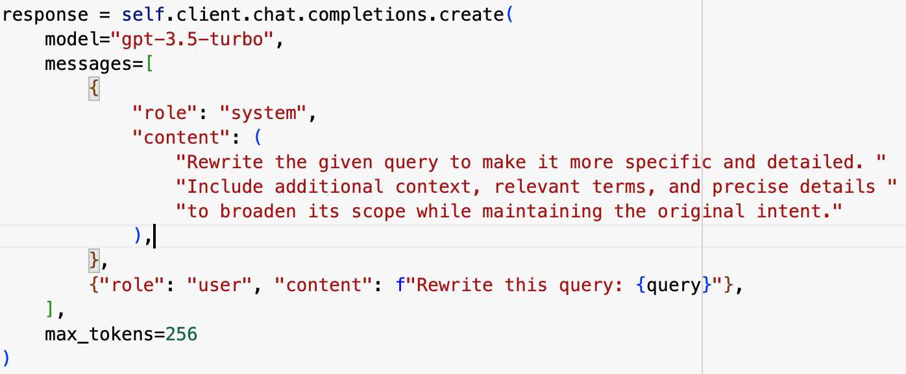
Query Rewriting Using OpenAI API
Steps:
Initialized the QueryRewriter class with an OpenAI API key.
Input queries (query_list_finder) were processed in a loop:
Sent to the OpenAI API with a system message guiding ChatGPT on the rewriting task.
Received rewritten queries as responses.
Stored rewritten queries in a dictionary for further use.

Slide 18
Query Rewriting Using OpenAI API
Input query → OpenAI API → Rewritten query → Stored result
Error Handling:
Implemented a fallback mechanism:
Original query is retained if the API fails to rewrite it.
Saving Output:
Option to save rewritten queries as a JSON file for reuse.
This single line turned out to be the key to solving our version-related issues and bringing everything together seamlessly.
!pip install openai==1.55.3 --force-reinstall --quiet

Slide 19
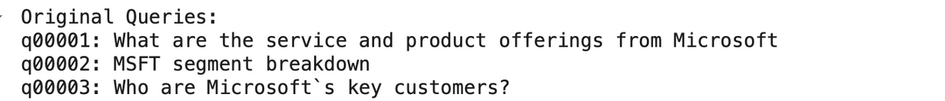
Query Rewriting Using OpenAI API
Why did we use Query Rewriting?
Improved Retrieval:
Rewritten queries provide additional context, making it easier to retrieve relevant documents.
Automation:
Simplifies query refinement using AI, eliminating manual efforts.
Scalability:
Can handle large-scale datasets with diverse queries.
Error Tolerance:
Fallback mechanism ensures no query is lost in case of API failure.
Results
Successfully rewritten queries stored in a dictionary.

Slide 20

Challenges Faced
API Updates: OpenAI's API underwent multiple updates, leading to changes in functionality and endpoints. These updates often resulted in compatibility issues with existing codebases.
FinQBench queries benefited from query expansion due to rich financial domain terms.
Challenges in Other Datasets: Insufficient synonym coverage in expanded queries. Query drift in generalized datasets.
Query expansion has potential, but its effectiveness is dataset-dependent. Tailored expansion strategies are needed for generalized datasets.
IMPLEMENTING THE QUERY REWRITING MODULE USING OPENAI'S API PRESENTED SEVERAL CHALLENGES, PRIMARILY DUE TO THE RECENT API UPDATES AND ASSOCIATED ERRORS.

Slide 21
Step 3: Vector Database
Goal:
To store precomputed dense embeddings for efficient use in the retrieval phase
Methodology:
Storage Method:
Saved query and document chunk embeddings as .npy files using NumPy.
For example for Finder, we stored in finder_corpus_embeddings.npy for 22,572 chunk embeddings (shape: 22,572 × 1024) and finder_query_embeddings.npy for 216 query embeddings (shape: 216 × 1024).
Advantages of Local Storage?
Flexibility: Easy to load and process embeddings for customized scoring functions.
Resource Efficiency: Avoids overhead from integrating with an external database

Slide 22
Step 3: Vector Database
Challenges we faced when using ChromaDB
ChromaDB does not expose direct access to perform custom embedding-level mathematical operations like element-wise subtraction, dot products, or transformations outside of the similarity functions it supports.
Why Local Storage Instead of ChromaDB?
Dense Retrieval Compatibility: The retrieval process in our code requires direct access to embedding matrices for cosine similarity or dot product scoring.
ChromaDB Limitation: While it supports vector search, it doesn’t allow embedding-level mathematical operations directly, which is critical for dense retrieval.

Slide 23
Step 4: Chunk Retrieval
Goal:
To retrieve the top-k relevant documents for each query by leveraging dense embeddings that capture semantic meaning.
Methodology:
Similarity Computation:
Cosine Similarity: Measures the cosine of the angle between query and document vectors. Chosen for its robustness in high-dimensional spaces.
Dot Product: Captures raw alignment between vectors, sometimes beneficial for certain embedding distributions.
Implementation:
Precomputed query and document embeddings were loaded from .npy files.
A pairwise similarity matrix was generated for all query and document embeddings using PyTorch functions.

Slide 24
Step 4: Chunk Retrieval
Methodology [continued]:
2. Dynamic Scaling of Initial Search (initial_k):
Why?
To ensure that even after normalization (deduplication of chunks), we retain enough candidates for top-k retrieval.
Process:
Initially retrieved 5× the desired number of documents (initial_k = top_k × 5, e.g., 50 for top-10 retrieval).
Allowed flexibility for downstream deduplication and ranking steps.

Slide 25
Step 4: Chunk Retrieval
Methodology [continued]:
3. Normalization and Deduplication:
Problem: Multiple chunks from the same document could appear in the top-k results, leading to redundancy.
Solution:
Grouped chunks by their parent document ID.
Retained only the chunk with the highest similarity score for each document.
Post-normalization Goal: Ensure the final top-k results represent distinct documents with the highest relevance.
4. Final Ranking:
Sorted the normalized results by similarity scores.
If fewer than top_k documents were available, padded results with placeholders (e.g., DUMMY) to ensure consistent output.

Slide 26
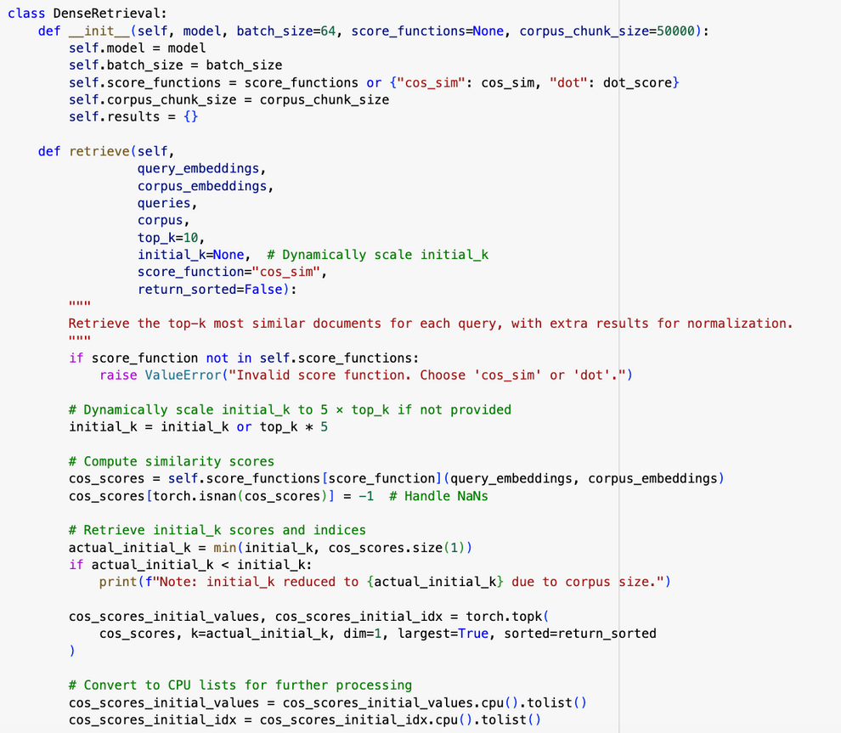
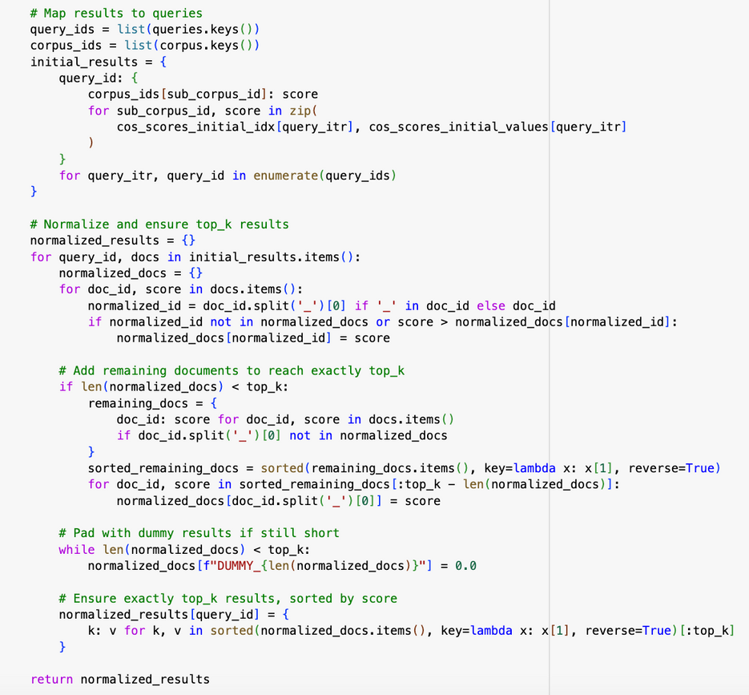
Step 4: Chunk Retrieval
Output: A dictionary mapping query IDs to their corresponding top-k document IDs and scores.

Slide 27
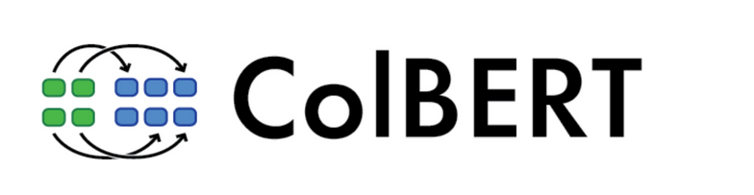
Re-Ranking with ColBERT
Even as “Miners,” we faced challenges when implementing hybrid retrieval and ColBERT for re-ranking.
Why It Didn’t Work
Indexing Bottleneck:
ColBERT required indexing the entire corpus into token embeddings for query-passage scoring.
This process was computationally expensive and extremely time-consuming.
Challenges Faced
Technical Challenges:
Difficulty in tuning the weight balance between dense and sparse retrieval.
Resource-intensive process for ColBERT re-ranking on large datasets.
Performance Issues:
No significant improvement in NDCG or MAP scores.
Inconsistent results across datasets; some datasets saw minor improvements, while others performed worse.

Slide 28
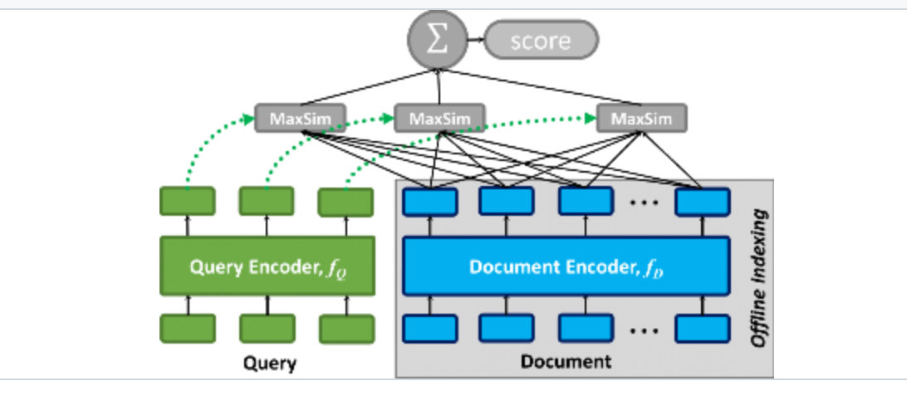
Why We Wanted to Use ColBERT
The Unique Power of ColBERT
Fine-Grained Similarity:
ColBERT captures contextual, token-level interactions between queries and documents.
Promises more precise retrieval compared to dense or sparse methods alone.
Late Interaction Architecture:
Instead of aggregating embeddings into single vectors, ColBERT evaluates fine-grained token interactions.
Enables nuanced scoring for complex queries.
Why We Believed It Would Work
Proven Performance:
ColBERT has consistently outperformed single-vector retrieval methods in benchmarks like MS MARCO.
Scalable Ranking:
Efficient token scoring (MaxSim) allows it to scale to larger corpora with detailed interaction modeling.

Slide 29
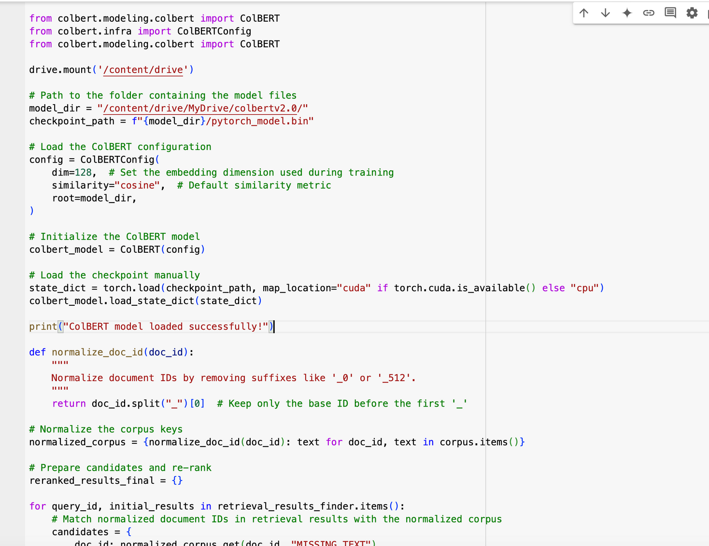
Why We Wanted to Use ColBERT

Slide 30
ChatGPT for Keyword Extraction + BM25 Retrieval
What We Tried
Keyword Extraction with ChatGPT:
BM25 Retrieval on Extracted Keywords:
Why We Tried This Approach
Leverage ChatGPT’s Language Understanding:
Aimed to improve retrieval by focusing on the core concepts of the query, as identified by ChatGPT.
Enhance BM25’s Effectiveness:
BM25 is great for exact matches but struggles with verbose or ambiguous queries.
Extracting key terms was expected to help BM25 deliver more relevant results.
Reduce Noise in Queries:
Simplify complex queries by removing irrelevant or redundant words.
Input Query → ChatGPT → Extracted Keywords
Keywords → BM25

Slide 31
Different Approaches for Dense Retrieval
What We Tried
Approach 1: Dense Retrieval that takes raw documents and queries as input and generates embeddings for them within the retrieve() function
Approach 2: Dense Retrieval that takes already generated embeddings as input (option we chose)
Why We Didn’t Choose Approach 1
Inefficiency: If documents and queries are encoded every time we call the retrieve() method, it can be computationally expensive especially when dealing with large datasets where the corpus remains static across queries.
Less Scalability: Without precomputed embeddings, integrating a vector database for efficient retrieval becomes more challenging.
Limited Flexibility: Debugging or switching components (e.g., embedding model, scoring functions) becomes harder as everything is tightly coupled.

Slide 32
Hybrid Retrieval (BM25 + DenseRetrieval)
What We Tried:
Use BM25 for initial retrieval based on keyword matching, the use Dense Retrieval to re-rank the top documents retrieved by BM25 based on semantic similarity.
Why We Tried This Approach
This approach could improve recall for sparse keywords and provide a good balance of speed and accuracy.
Challenges We Faced
Numerous errors faced during the retrieval process such as certain queries having no valid BM25 candidates, resulting in empty retrieval results for those queries.
We tried multiple approaches for implementing Hybrid Retrieval (a simple one that directly integrates BM25 and Dense Retrieval and more modular one where BM25 candidates are passed to a dense retrieval function for re-ranking) but all led to errors.
Input → BM25 → DenseRetrieval → Evaluation

Slide 33
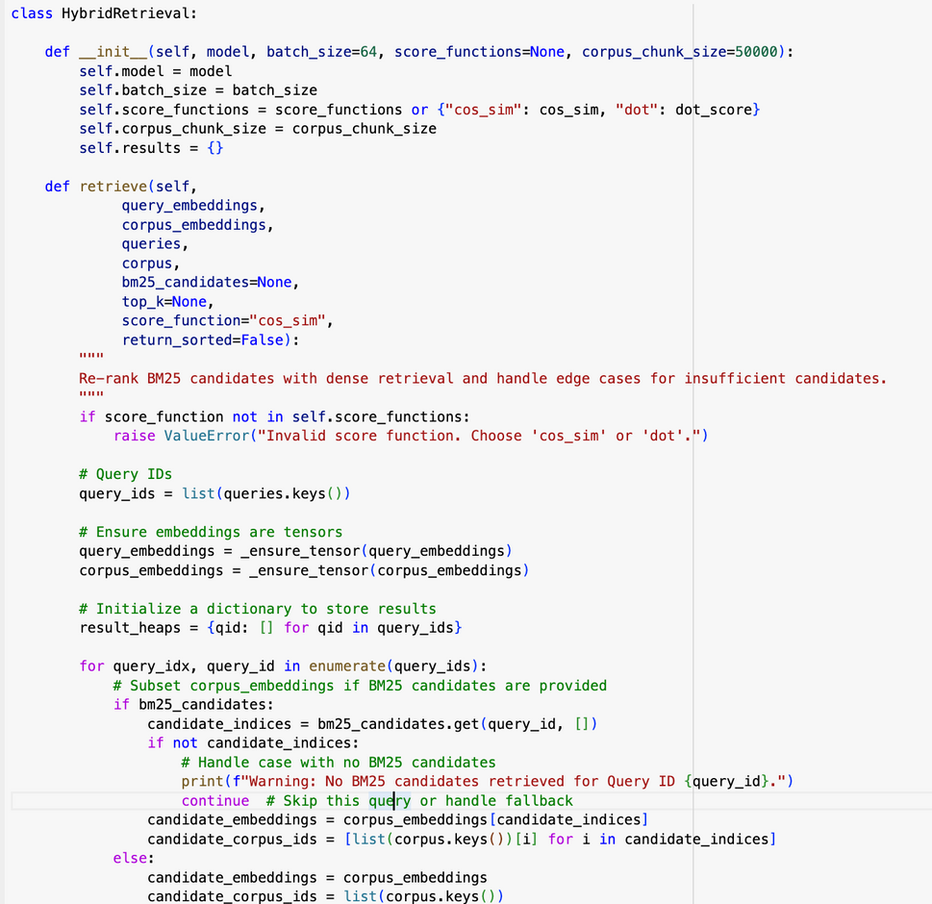
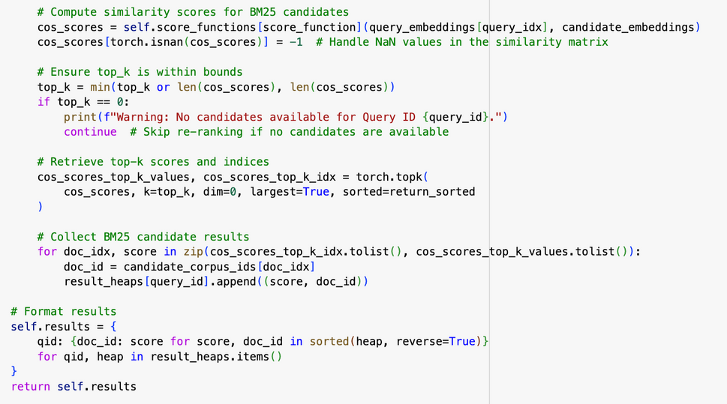
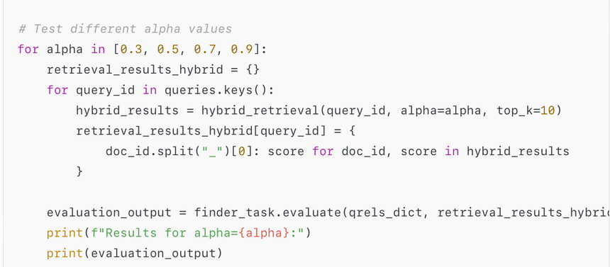
Hybrid Retrieval (BM25 + DenseRetrieval)
Note: The above implementation of Hybrid Retrieval may not be the best or correct one, but this is one of the implementations we tried

Slide 34
Different Chunking Methods
What We Tried
No additional re-chunking
Semantic Chunking
Overlap Chunking(option we chose)
Why Semantic Chunking?
Financial text is dense, and relevance often depends on capturing nuances (e.g., relationships between sentences).
Semantic chunking can capture the meaning and context even if the structure isn’t explicitly labeled. It could be particularly effective if the document text flows without clear section markers.
Issue faced with Semantic Chunking:
NDCG score dropped in comparison to the score we got when using Overlap Chunking
Issue faced when not doing re-chunking at all:
Some of the documents were too large for our model Stella which generally performs best when max size of documents is 512.

Slide 35
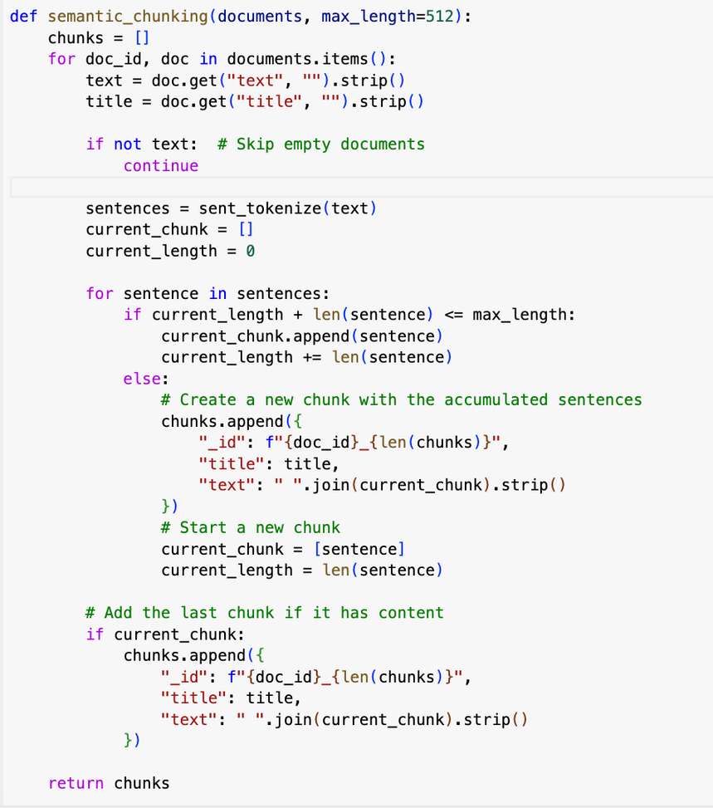
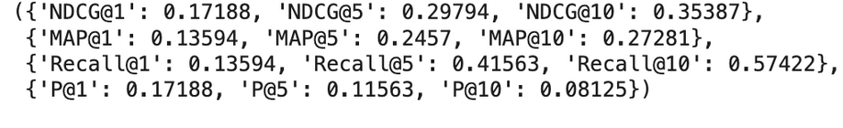
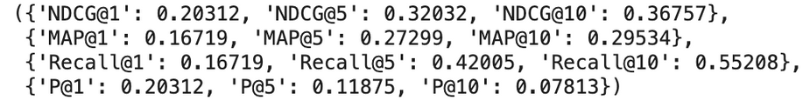
Different Chunking Methods
What We Tried
No additional chunking
Semantic Chunking
Overlap Chunking(option we chose)
Evaluation for Finder when using Semantic Chunking
Evaluation for Finder when using Overlap Chunking
for the same model

Slide 36
IE261
Thank You
for Your Attention!
TEAM MEMBERS:
Agata Kazakevic, Symbat Bekzhigit

